Slide 1
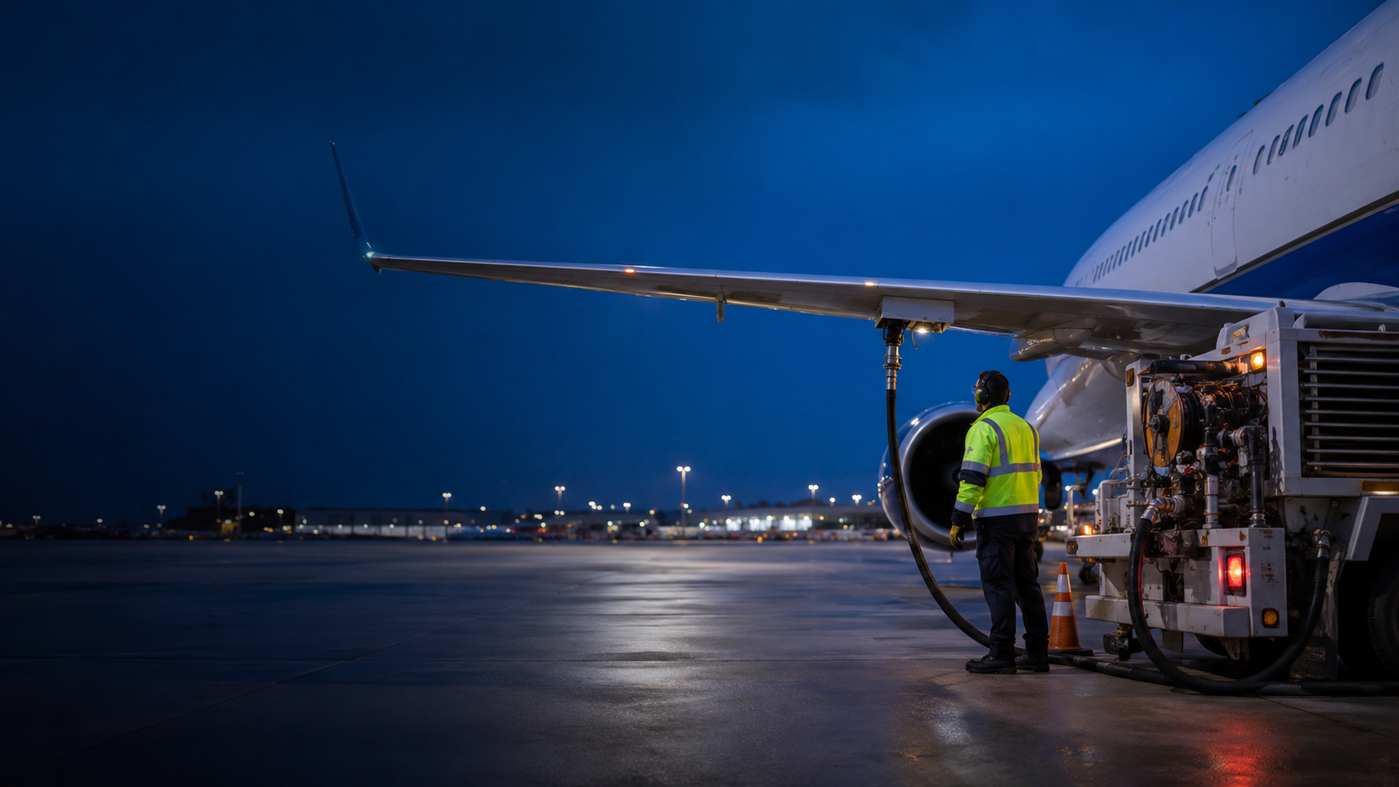

AVIATION FUEL HANDLING
Safety is a sequence of controlled decisions
Prepare. Connect. Monitor. Stop. Respond.
PORTFOLIO DEMO
HYBRID DELIVERY
Independent portfolio concept. Not affiliated with United Airlines.
Notes:
Facilitator guidance:
Open with the idea that fueling safety is not a single rule. It is a linked sequence. State that this portfolio demo supplements, but does not replace, airport, operator, aircraft, and fire code procedures.
Self guided cue:
Use the on screen controls or PowerPoint navigation to continue.
[Sources]
• https://www.united.com/icons/icon-512x512.png
• https://www.faa.gov/documentLibrary/media/Advisory_Circular/150-5230-4C-Aircraft-Fuel-20260617.pdf
• Original image generated for this portfolio concept on 2026-08-19.

Slide 2
FUEL HANDLING SAFETY
Safe fueling depends on the next correct action
Fuel is routine until one barrier breaks.
1
Prepare
2
Connect
Your job is to keep each barrier in place before, during, and after fuel flow.
3
Monitor
4
Stop
START THE DEMO
5
Respond
Independent portfolio concept. Not affiliated with United Airlines.
02
Notes:
Facilitator guidance:
Ask the group which barrier is easiest to skip under schedule pressure. Use their answers to introduce the five step sequence. Select Start the Demo in slide show mode to continue.
Self guided cue:
Use the on screen controls or PowerPoint navigation to continue.
[Sources]
• https://www.united.com/icons/icon-512x512.png
• https://www.ecfr.gov/current/title-14/chapter-I/subchapter-G/part-139/subpart-D/section-139.321
• https://www.faa.gov/documentLibrary/media/Advisory_Circular/150-5230-4C-Aircraft-Fuel-20260617.pdf

Slide 3
CLICKABLE COURSE MAP
Use the sequence as your decision map
Select any stage to jump to that part of the demo.
01
02
03
04
05
Prepare
Connect
Monitor
Stop
Respond
Scan the ramp and confirm readiness
Bond, inspect, and connect deliberately
Keep control of the live fueling zone
Recognize conditions that require a pause
Stop the source, protect people, and notify
The sequence repeats on every aircraft, every shift.
Independent portfolio concept. Not affiliated with United Airlines.
03
Notes:
Facilitator guidance:
This slide is the persistent navigation point for the self guided version. In live delivery, use it as a section map. Each stage is clickable in slide show mode.
Self guided cue:
Use the on screen controls or PowerPoint navigation to continue.
[Sources]
• https://www.united.com/icons/icon-512x512.png
• https://www.faa.gov/documentLibrary/media/Advisory_Circular/150-5230-4C-Aircraft-Fuel-20260617.pdf

Slide 4
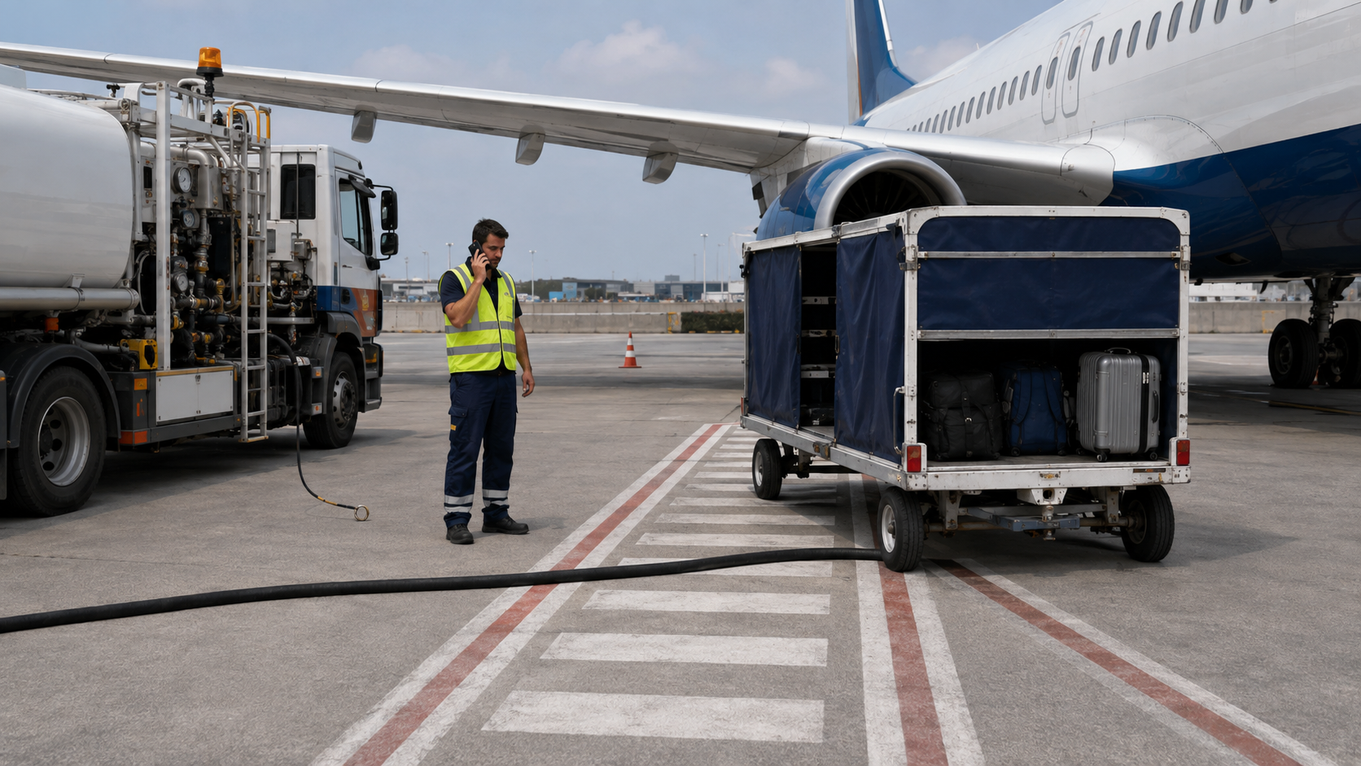
Scan the ramp before fuel flow
Find four conditions that call for a pause.
?
?
?
?
REVEAL ALL FOUR
Independent portfolio concept. Not affiliated with United Airlines.
MAP
04
Notes:
Facilitator guidance:
Give learners 30 seconds to scan the image. Ask them to describe what they see before naming the rule. Select any question marker or Reveal All Four to continue.
Self guided cue:
Use the on screen controls or PowerPoint navigation to continue.
[Sources]
• https://www.united.com/icons/icon-512x512.png
• https://www.faa.gov/documentLibrary/media/Advisory_Circular/150-5230-4C-Aircraft-Fuel-20260617.pdf
• Original image generated for this portfolio concept on 2026-08-19.

Slide 5
Four clues change the decision
Any one is enough to pause the job.
PHONE AND INCOMPLETE PPE
EXIT ROUTE BLOCKED
LOOSE BONDING CABLE
SCAN AGAIN
HOSE CROSSES WALKING PATH
CONTINUE
Independent portfolio concept. Not affiliated with United Airlines.
MAP
05
Notes:
Facilitator guidance:
Confirm all four hazards. Emphasize that the goal is not to collect violations. The goal is to make the stop or pause decision before fuel moves.
Self guided cue:
Use the on screen controls or PowerPoint navigation to continue.
[Sources]
• https://www.united.com/icons/icon-512x512.png
• https://www.faa.gov/documentLibrary/media/Advisory_Circular/150-5230-4C-Aircraft-Fuel-20260617.pdf
• Original image generated for this portfolio concept on 2026-08-19.

Slide 6
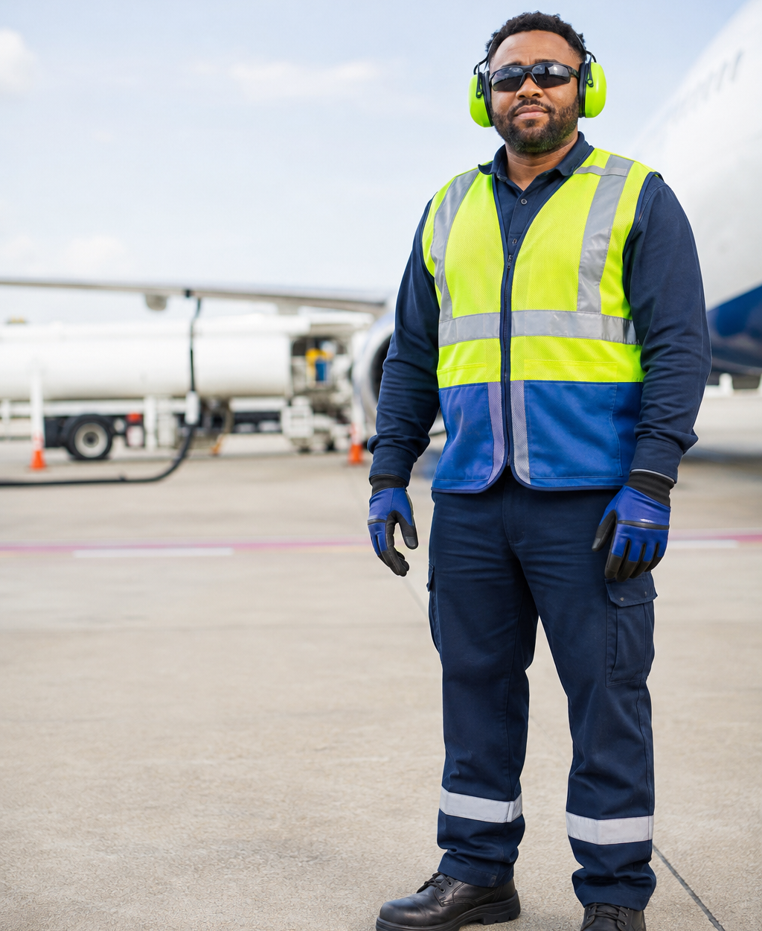
DECISION POINT
Would you begin fueling?
You are two minutes behind schedule.
The fuel order matches the aircraft.
Your eye protection remains in the cab.
A baggage tug is approaching the rear of the truck.
Choose the next action.
PROCEED
PAUSE
Independent portfolio concept. Not affiliated with United Airlines.
MAP
06
Notes:
Facilitator guidance:
Ask learners to choose without discussion first. Then invite one person from each choice to explain the decision. The correct choice is Pause because PPE and vehicle movement risks are not controlled.
Self guided cue:
Use the on screen controls or PowerPoint navigation to continue.
[Sources]
• https://www.united.com/icons/icon-512x512.png
• https://www.faa.gov/documentLibrary/media/Advisory_Circular/150-5230-4C-Aircraft-Fuel-20260617.pdf
• Original image generated for this portfolio concept on 2026-08-19.

Slide 7
DECISION FEEDBACK
Proceed trades schedule pressure for uncontrolled risk
NOT YET
PAUSE
The order is correct, but the job is not ready.
Return to the prejob pause. Put on required PPE. Clear the vehicle route. Confirm the ramp is stable.
TRY AGAIN
Independent portfolio concept. Not affiliated with United Airlines.
MAP
07
Notes:
Facilitator guidance:
Connect the feedback to stop work authority. A schedule delay is visible. An uncontrolled hazard may be less visible, but it still changes the decision.
Self guided cue:
Use the on screen controls or PowerPoint navigation to continue.
[Sources]
• https://www.united.com/icons/icon-512x512.png
• https://www.faa.gov/documentLibrary/media/Advisory_Circular/150-5230-4C-Aircraft-Fuel-20260617.pdf

Slide 8
DECISION FEEDBACK
Pause resets the job before fuel moves
CORRECT
A pause is a safety action.
01
Complete PPE
Use the eye, hearing, hand, clothing, and footwear protection required for the task.
Resume only when the conditions are controlled and communication is clear.
02
Clear the route
Keep the fuel vehicle stable and preserve an unobstructed path away from the aircraft.
CONTINUE
Independent portfolio concept. Not affiliated with United Airlines.
MAP
08
Notes:
Facilitator guidance:
Reinforce the language of a safety pause. Supervisors should support the decision and help remove the condition rather than simply telling the employee to work around it.
Self guided cue:
Use the on screen controls or PowerPoint navigation to continue.
[Sources]
• https://www.united.com/icons/icon-512x512.png
• https://www.faa.gov/documentLibrary/media/Advisory_Circular/150-5230-4C-Aircraft-Fuel-20260617.pdf

Slide 9
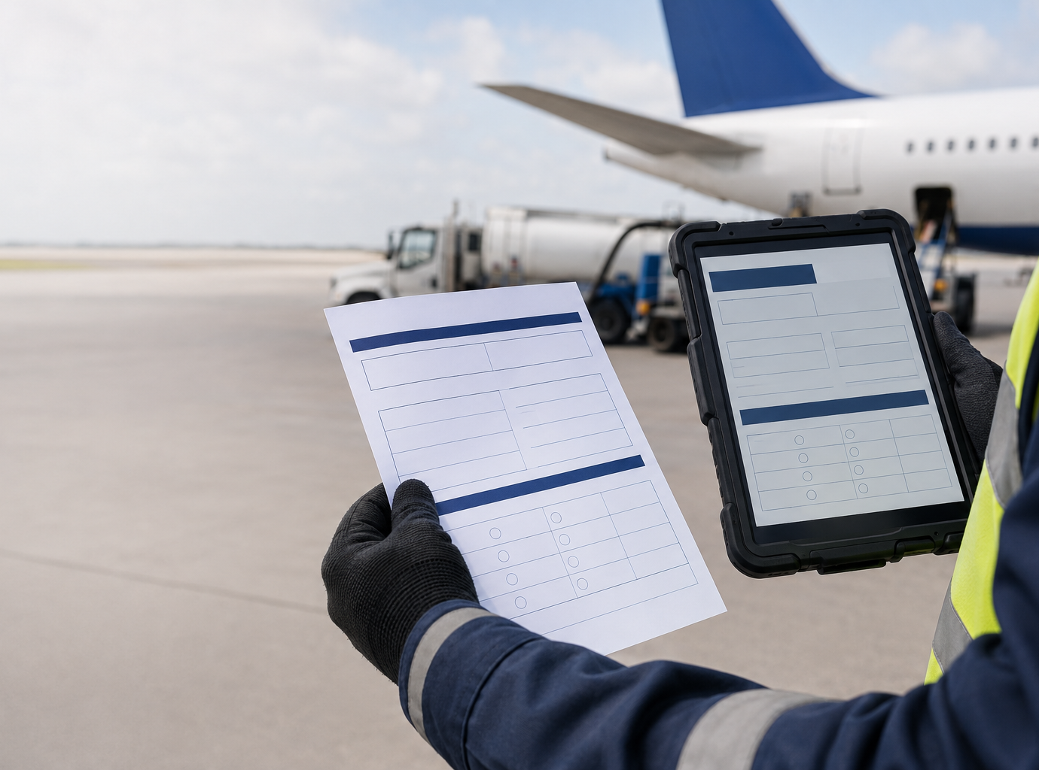
PREPARE
Match the order to the aircraft before approach
PAPER ORDER
DIGITAL RECORD
Four points must agree
01
Aircraft registration
02
Fuel type and grade
03
Requested quantity and tank distribution
04
Required additives
MATCH 4 FIELDS
If anything does not match, stop and verify.
Independent portfolio concept. Not affiliated with United Airlines.
MAP
09
Notes:
Facilitator guidance:
Ask who owns each verification point in the local process. The FAA fuel safety curriculum identifies aircraft registration, fuel type and grade, volume and distribution, and additives as components of a correct fuel order.
Self guided cue:
Use the on screen controls or PowerPoint navigation to continue.
[Sources]
• https://www.united.com/icons/icon-512x512.png
• https://www.faa.gov/documentLibrary/media/Advisory_Circular/150-5230-4C-Aircraft-Fuel-20260617.pdf
• Original image generated for this portfolio concept on 2026-08-19.

Slide 10
CONTAMINATION CONTROL
DEF does not belong in jet fuel
Two clear fluids can carry very different consequences.
DEF
FSII
SUSPECTED
MIXUP
Diesel exhaust fluid
Fuel system icing inhibitor
Stop. Isolate. Notify. Follow the operator contamination process.
Keep separate. Label clearly. Control who handles it.
Use only through approved equipment and procedures.
Do not repurpose suspected contaminated fuel.
Independent portfolio concept. Not affiliated with United Airlines.
MAP
10
Notes:
Facilitator guidance:
Use the NTSB alert to explain why DEF and FSII storage and labeling matter. Keep the focus on positive controls. Separate storage, unmistakable labeling, restricted handling, and immediate isolation when contamination is suspected.
Self guided cue:
Use the on screen controls or PowerPoint navigation to continue.
[Sources]
• https://www.united.com/icons/icon-512x512.png
• https://www.faa.gov/documentLibrary/media/Advisory_Circular/150-5230-4C-Aircraft-Fuel-20260617.pdf
• https://www.ntsb.gov/advocacy/safety-alerts/Documents/SA-079.pdf

Slide 11
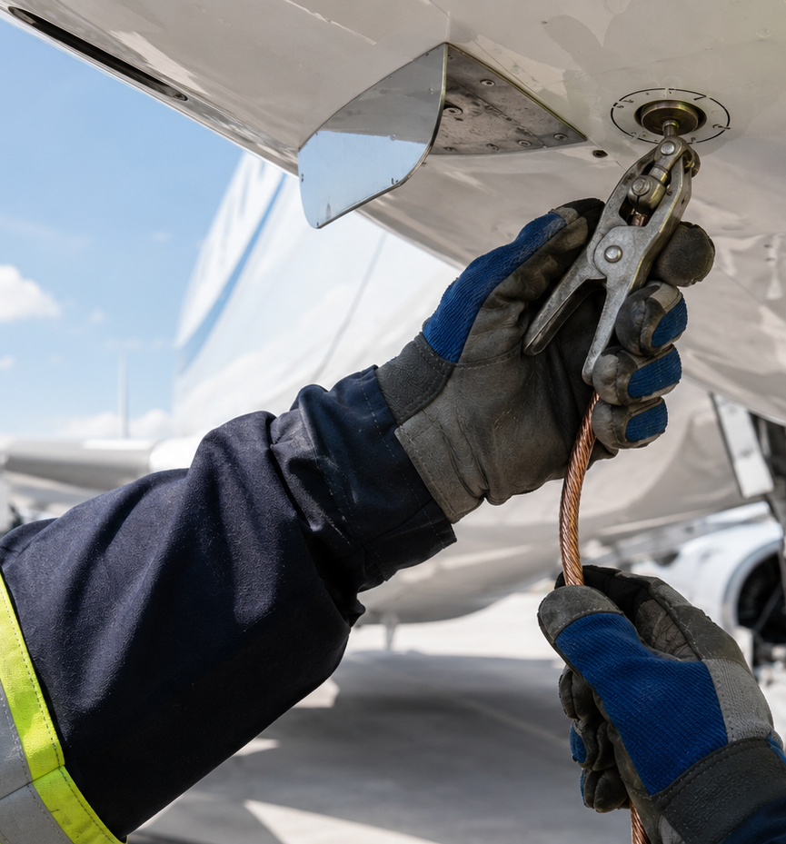
CONNECT
Bond first. Fuel second.
Control static before the fueling connection is made.
1
Inspect the cable and clamp
2
Attach to the designated bonding point
3
Connect the nozzle after bonding
4
Maintain the bond through disconnection
Follow aircraft and operator bonding procedures.
Independent portfolio concept. Not affiliated with United Airlines.
MAP
11
Notes:
Facilitator guidance:
Clarify the difference between bonding and grounding based on local procedures. The learning point here is sequence. The approved bond is established before the fueling connection and maintained until the connection is removed.
Self guided cue:
Use the on screen controls or PowerPoint navigation to continue.
[Sources]
• https://www.united.com/icons/icon-512x512.png
• https://www.faa.gov/documentLibrary/media/Advisory_Circular/150-5230-4C-Aircraft-Fuel-20260617.pdf
• Original image generated for this portfolio concept on 2026-08-19.

Slide 12
CONNECT
Park for a clear exit and a stable platform
The fuel vehicle should be ready to move away without backing toward the aircraft.
FUEL VEHICLE
AIRCRAFT
CLEAR EXIT
Parking brake and chocks set as required
Extinguisher and shutoff access clear
Interlocks and controls checked
Hose protected from traffic and sharp bends
Independent portfolio concept. Not affiliated with United Airlines.
MAP
12
Notes:
Facilitator guidance:
Use the diagram to discuss local vehicle placement rules, interlocks, chocks, parking requirements, emergency shutoff access, and separation distances. Do not teach a universal distance. Refer learners to the airport and operator standard.
Self guided cue:
Use the on screen controls or PowerPoint navigation to continue.
[Sources]
• https://www.united.com/icons/icon-512x512.png
• https://www.faa.gov/documentLibrary/media/Advisory_Circular/150-5230-4C-Aircraft-Fuel-20260617.pdf

Slide 13
CONNECT
Connect deliberately, disconnect cleanly
01
Verify
Aircraft, order, equipment, route, and communication
02
Bond
Attach at the designated point before connection
03
Connect
Inspect coupling and secure the fueling connection
04
Control
Begin flow with the required control in hand
05
Close
Stop flow, disconnect, remove bond, and stow
Independent portfolio concept. Not affiliated with United Airlines.
MAP
13
Notes:
Facilitator guidance:
Walk through the sequence at a high level. Ask learners to name the operator specific checklist or control used at each step. Avoid substituting this demo for equipment specific hands on instruction.
Self guided cue:
Use the on screen controls or PowerPoint navigation to continue.
[Sources]
• https://www.united.com/icons/icon-512x512.png
• https://www.faa.gov/documentLibrary/media/Advisory_Circular/150-5230-4C-Aircraft-Fuel-20260617.pdf

Slide 14
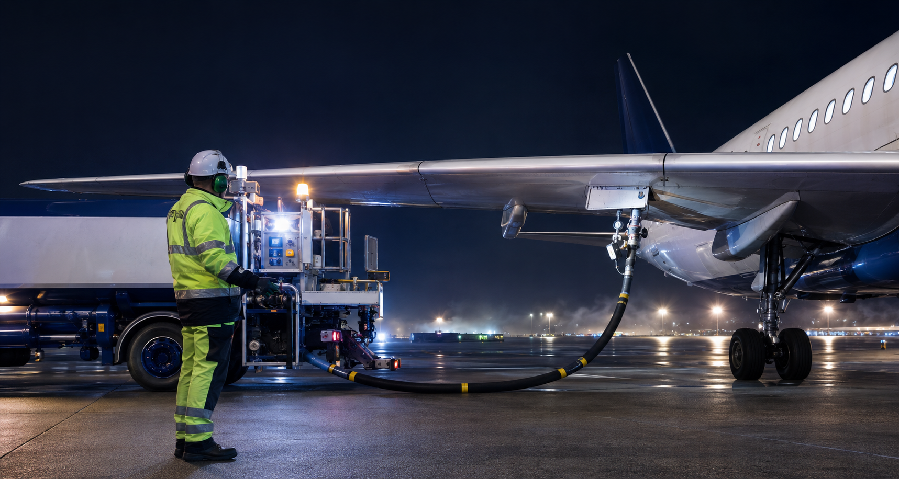
Monitoring means staying in control
Stay at the assigned control point. Watch the operation, not the clock.
Hose and coupling
Leaks, movement, strain, or an abnormal connection
Aircraft area
Fuel panel, vents, wing area, and nearby equipment
Vehicle and route
Interlocks, brakes, traffic, and clear egress
People and weather
Communication, ignition sources, lightning, and local limits
Independent portfolio concept. Not affiliated with United Airlines.
MAP
14
Notes:
Facilitator guidance:
Ask learners what normal looks like at the control point. Then ask what changes would be visible, audible, or communicated. Connect answers to the stop triggers on the next slide.
Self guided cue:
Use the on screen controls or PowerPoint navigation to continue.
[Sources]
• https://www.united.com/icons/icon-512x512.png
• https://www.faa.gov/documentLibrary/media/Advisory_Circular/150-5230-4C-Aircraft-Fuel-20260617.pdf
• Original image generated for this portfolio concept on 2026-08-19.

Slide 15
KNOWLEDGE CHECK
What would make you stop?
Choose every condition that requires fuel flow to stop. Discuss first, then reveal.
A
A leak appears at the coupling
B
The flight crew requests a pause
C
A light rain begins within local limits
D
The bonding cable becomes loose
E
The planned quantity displays normally
F
A fueling control behaves unexpectedly
REVEAL ANSWER
Independent portfolio concept. Not affiliated with United Airlines.
MAP
15
Notes:
Facilitator guidance:
Have learners commit to selections before revealing. The stop conditions are A, B, D, and F. C and E describe normal conditions, but local procedures always govern.
Self guided cue:
Use the on screen controls or PowerPoint navigation to continue.
[Sources]
• https://www.united.com/icons/icon-512x512.png
• https://www.faa.gov/documentLibrary/media/Advisory_Circular/150-5230-4C-Aircraft-Fuel-20260617.pdf

Slide 16
KNOWLEDGE CHECK FEEDBACK
Stop when control is lost or conditions change
A
Leak at coupling
B
Crew requests pause
STOP
STOP
C
Light rain within limits
D
Bond becomes loose
CONTINUE WITHIN PROCEDURE
STOP
E
Quantity displays normally
F
Control behaves unexpectedly
CONTINUE WITHIN PROCEDURE
STOP
When in doubt, pause and verify with the authorized lead.
TRY AGAIN
CONTINUE
Independent portfolio concept. Not affiliated with United Airlines.
MAP
16
Notes:
Facilitator guidance:
Review why each true condition breaks control. Reinforce that local lightning, weather, passenger, and emergency requirements may add other stop conditions.
Self guided cue:
Use the on screen controls or PowerPoint navigation to continue.
[Sources]
• https://www.united.com/icons/icon-512x512.png
• https://www.faa.gov/documentLibrary/media/Advisory_Circular/150-5230-4C-Aircraft-Fuel-20260617.pdf

Slide 17
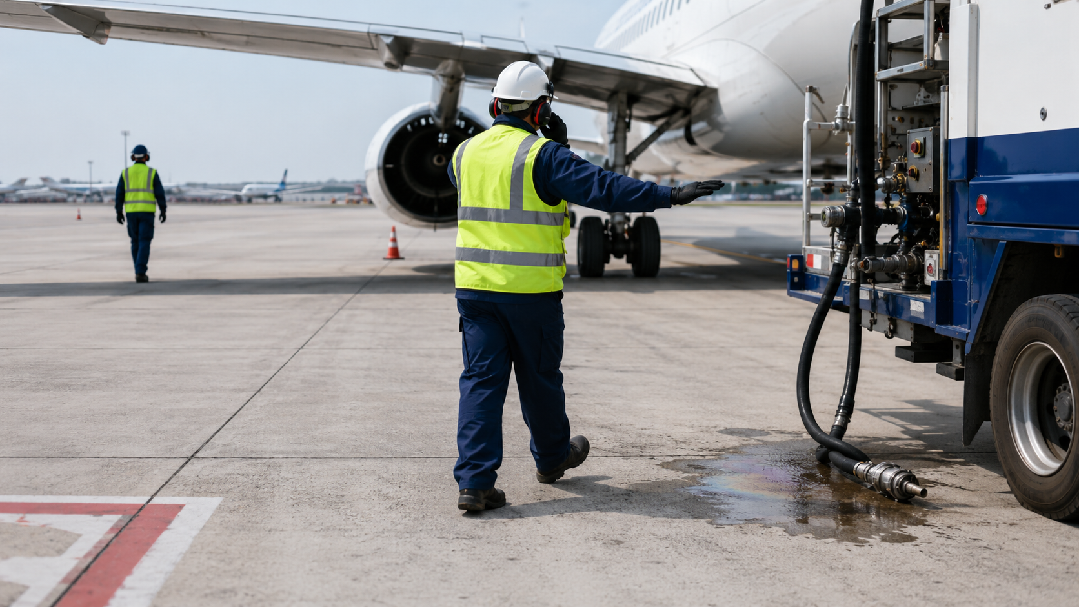
A leak appears at the coupling
What do you do first?
A
Get absorbent material and contain the spill while fuel continues.
Stop fuel flow, use emergency controls as required, warn others, and notify.
B
Independent portfolio concept. Not affiliated with United Airlines.
MAP
17
Notes:
Facilitator guidance:
Ask learners to identify the first action, not every action. The safe path is B. Stop the source before approaching containment. Then protect people, notify, and respond within training and local procedures.
Self guided cue:
Use the on screen controls or PowerPoint navigation to continue.
[Sources]
• https://www.united.com/icons/icon-512x512.png
• https://www.faa.gov/documentLibrary/media/Advisory_Circular/150-5230-4C-Aircraft-Fuel-20260617.pdf
• Original image generated for this portfolio concept on 2026-08-19.

Slide 18
SCENARIO FEEDBACK
Containment is not the first move while fuel is flowing
STOP THE SOURCE FIRST
STOP
Approaching a live leak can place you in the spill and delay the action that limits the release.
Return to the scenario. Select the action that stops fuel flow, protects people, and starts the notification process.
TRY AGAIN
Independent portfolio concept. Not affiliated with United Airlines.
MAP
18
Notes:
Facilitator guidance:
Explain that spill response training defines who may contain, what PPE and materials are required, and when aircraft rescue and firefighting support is needed. This feedback focuses only on the first decision.
Self guided cue:
Use the on screen controls or PowerPoint navigation to continue.
[Sources]
• https://www.united.com/icons/icon-512x512.png
• https://www.faa.gov/documentLibrary/media/Advisory_Circular/150-5230-4C-Aircraft-Fuel-20260617.pdf

Slide 19
SCENARIO FEEDBACK
Stop the source. Protect people. Notify. Respond.
1
2
3
4
Stop fuel flow
Protect people
Notify
Respond
Release the control and activate emergency shutoff actions as required.
Warn others and keep ignition sources and traffic away from the affected area.
Contact the authorized lead and emergency support through the local process.
Contain only if trained, equipped, and conditions are safe.
Follow local spill reporting and emergency procedures.
FINISH
Independent portfolio concept. Not affiliated with United Airlines.
MAP
19
Notes:
Facilitator guidance:
Use this action sequence as a memory aid. Ask learners to name the actual emergency shutoff, radio call, spill threshold, and response contact at their airport.
Self guided cue:
Use the on screen controls or PowerPoint navigation to continue.
[Sources]
• https://www.united.com/icons/icon-512x512.png
• https://www.faa.gov/documentLibrary/media/Advisory_Circular/150-5230-4C-Aircraft-Fuel-20260617.pdf

Slide 20
The safest decision is the next controlled decision
PREPARE
CONNECT
MONITOR
STOP
RESPOND
Use airport, operator, aircraft, and fire code procedures for every fueling operation.
RESTART DEMO
Independent portfolio concept. Not affiliated with United Airlines.
20
Notes:
Facilitator guidance:
Close by asking each learner to name one condition that would make them pause a fueling job. Remind the audience that this deck is a portfolio demo and not an approved United Airlines training course.
Self guided cue:
Use the on screen controls or PowerPoint navigation to continue.
[Sources]
• https://www.united.com/icons/icon-512x512.png
• https://www.faa.gov/documentLibrary/media/Advisory_Circular/150-5230-4C-Aircraft-Fuel-20260617.pdf
• https://www.ecfr.gov/current/title-14/chapter-I/subchapter-G/part-139/subpart-D/section-139.321

